Slide 1
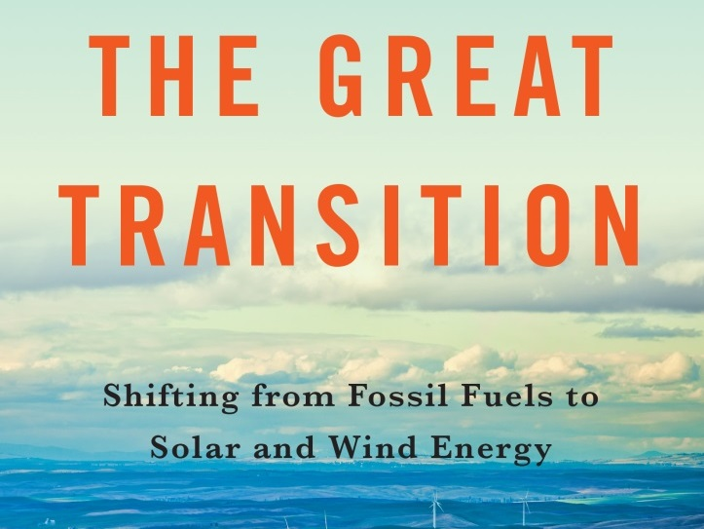

Slide 2
A presentation for
The Great Transition: Shifting from Fossil Fuels to Solar and Wind Energy
A book by
Lester R. Brown
with Janet Larsen, J. Matthew Roney, and Emily E. Adams

Slide 3
Contents
Changing Direction
The Rise and Fall of Oil
Closing Coal Plants
Nuclear Power in Decline
The Solar Revolution
The Age of Wind
Tapping the Earth’s Heat
Hydropower: Past and Future
Accelerating the Transition

Slide 4
Changing Direction
The worldwide transition from fossil fuels to renewable sources of energy is under way. As fossil fuel resources shrink, as air pollution worsens, and as concerns about climate instability cast a shadow over the future of coal, oil, and natural gas, a new world energy economy is emerging. The old economy, fueled largely by coal and oil, is being replaced with one powered by solar and wind energy.
– Chapter 1, The Great Transition

Slide 5
Glimpses of the Energy Transition
South Australia: Wind farms supply more electricity than coal plants
China: Water for 170 million households is heated by rooftop solar water heaters
United Kingdom: For several days in August 2014, wind electricity eclipsed that from coal
Spain: Wind is close to overtaking nuclear power as the leading source of electricity

Slide 6
Global Annual Energy Growth, 2008-2013

Slide 7
Drivers
Economic: Cost of renewables falling
Technological: Advances in PV, batteries
Social: Growing opposition to coal and nuclear power
Geological: Remaining fossil fuels harder to access and more costly
Climatic: Carbon emissions destabilizing the climate, threatening civilization

Slide 8
Climate Disruption
Fossil fuel burning is increasing carbon dioxide (CO₂) levels in the atmosphere, raising the earth’s temperature
Continued heavy fossil fuel reliance could raise the global temperature up to 6°C (nearly 11°F) by 2100

Slide 9
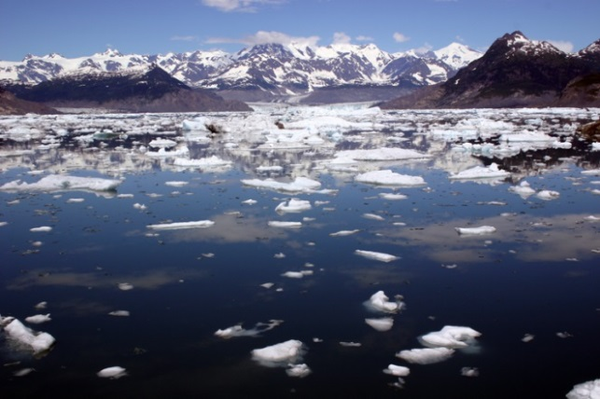
2° Safety Limit
The international community agreed to limit warming to 2°C (3.6°F) to prevent dangerous climate change
Higher temperatures:
Melt ice sheets and glaciers
Raise sea level
Increase drought in some areas
Intensify rainfall in others
Cause more-destructive storms
Photo Credit: Nomadic Lass (Flickr: Columbia Glacier)

Slide 10
Stranded Assets
To keep global warming to 2°C, most fossil fuels need to stay in the ground
Fossil energy companies will likely lose value
Related infrastructure may also become stranded
Power plants
Coal mines
Pipelines
Coal handling and storage facilities
Photo credit: Emily Adams

Slide 11
THE RISE AND FALL
OF OIL
Photo Credit: U.S. Coast Guard

Slide 12
The Rise and Fall of Oil
Worldwide oil use continues to grow
But “easy oil” is getting tapped out
In some countries, like the United States and Japan, oil use has peaked and is on the decline

Slide 13
U.S. Oil Use Down
U.S. Oil Consumption and Production, 1965-2014
U.S. #1 consumer
U.S. oil use fell 8.5% from 2005 to 2014
People driving less
Better vehicle efficiency
Public transit expanding
Culture change: young people no longer prioritizing cars
Car sharing and bike sharing spreading

Slide 14
Natural Gas: A Bridge to Nowhere
Horizontal drilling and hydraulic fracturing (“fracking”) have created a U.S. oil and gas boom
Methane leaks along the supply chain mean gas may be more climate disrupting than coal
Other concerns: wasted investment in short-term infrastructure; water and air pollution; earthquakes
Photo Credit: Bilfinger SE/U.S. Department of Energy

Slide 15
CLOSING COAL PLANTS
Photo Credit: National Renewable Energy Laboratory

Slide 16
World Electricity Profile, 2012

Slide 17
Coal: Last Century’s Dirty Fuel
Air pollution from coal-burning leads to heart and lung diseases, early death
Leading source of CO₂ emissions
Coal-fired power plants require large amounts of water

Slide 18
Coal Plants Closing
Coal Consumption in the United States, 1965-2014
Lower natural gas prices, air pollution regulations, and local campaigns are closing coal plants across the United States
Of the 523 U.S. coal-fired power plants, 188 have recently closed or plan to close
Australia, Canada, and many E.U. countries have also passed peak coal

Slide 19
Peak Coal in China?
China’s coal use:
Exceeds the rest of the world combined
But fell in 2014 for the first time in recent history
Peak coal is near:
Air pollution concerns
Environmental regulations
Wind and solar booming
Improving efficiency
Slowing economic growth
U.S.-China climate agreement

Slide 20
India Coal Use Growing
Indian government claims to be doubling down on coal, planning hundreds of new plants
How many will be built remains to be seen
Urban air pollution worse than in China
Local opposition to coal
Taxes on coal doubled, partly funding solar development
Solar costs undercut the grid in much of the country

Slide 21
NUCLEAR POWER IN DECLINE
Photo Credit: Sandia Science & Technology Park

Slide 22
Nuclear Power in Decline
Global nuclear generation peaked in 2006
Peaked in France in 2005; United States in 2010
Number of operating reactors dropped from high of 438 in 2002 to 390 as of end-2014

Slide 23
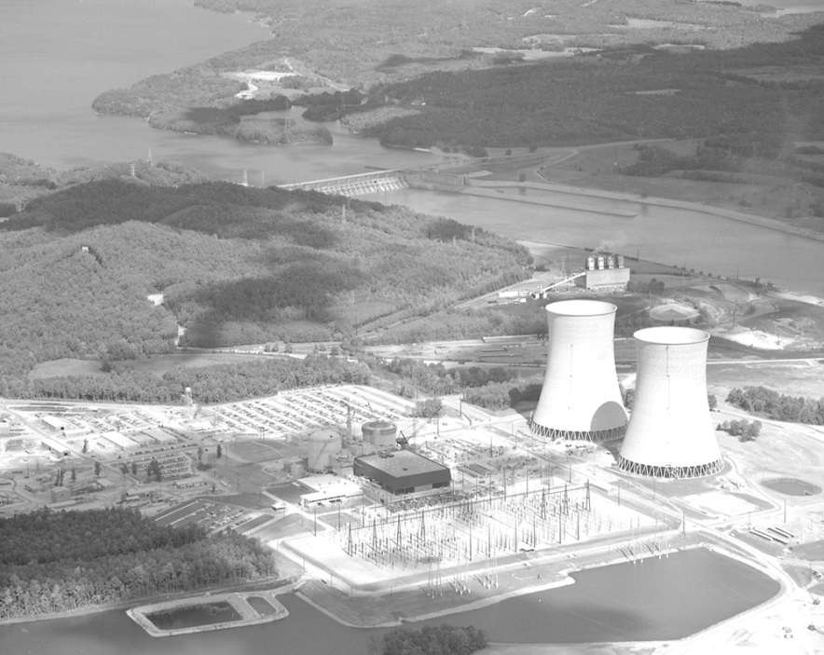
Costly from Cradle…
Unlike with wind and solar power, building new nuclear facilities has become more expensive over time
Construction delays and cost overruns are typical features of nuclear projects
Of 66 reactors under construction in mid-2014, 49 were behind schedule, including all 5 in the United States and 20 of 27 in China
Photo Credit: Wikimedia Commons/ Tennessee Valley Authority

Slide 24
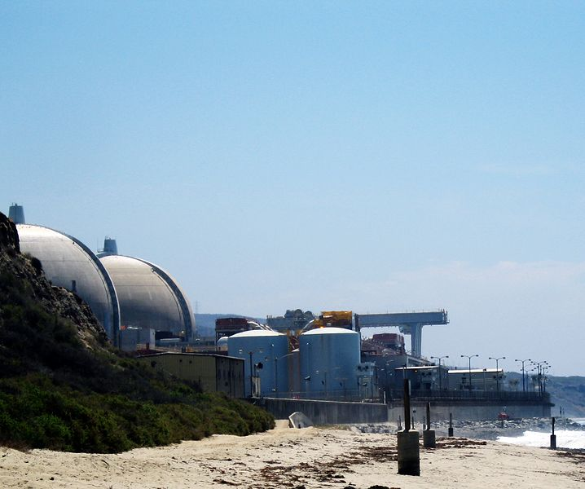
…to Grave
Costs rising for aging plants—operation, maintenance, fuel
Squeezed by cheap renewables and natural gas, 5 U.S. reactors have retired early since 2013
Closing is costly: ~$4.4 billion for two California reactors; $130 billion for 4-reactor U.K. site with legacy of weapons-grade plutonium
Nuclear waste disposal problem remains unresolved
Photo credit: Wikimedia Commons/awnisALAN

Slide 25
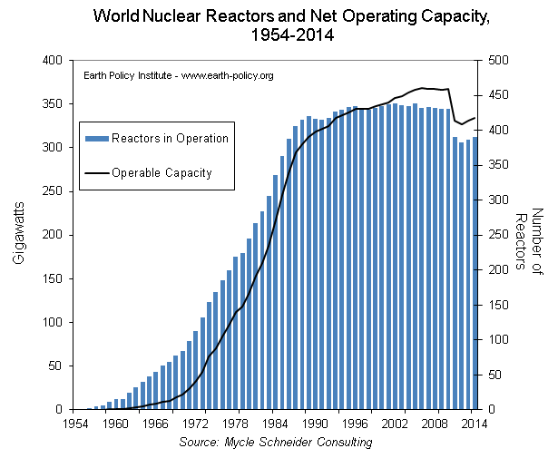
Fukushima Meltdown Hastens Decline
2011 earthquake/tsunami crippled Fukushima plant, leaked radiation
All Japanese reactors eventually off-line; no nuclear generation since mid-2013, as of early 2015
Germany, Switzerland, Belgium announced nuclear phase-outs
France cutting nuclear reliance from 75% of electricity to 50% by 2025
Data provided by: Mycle Schneider Consulting www.worldnuclearreport.org

Slide 26
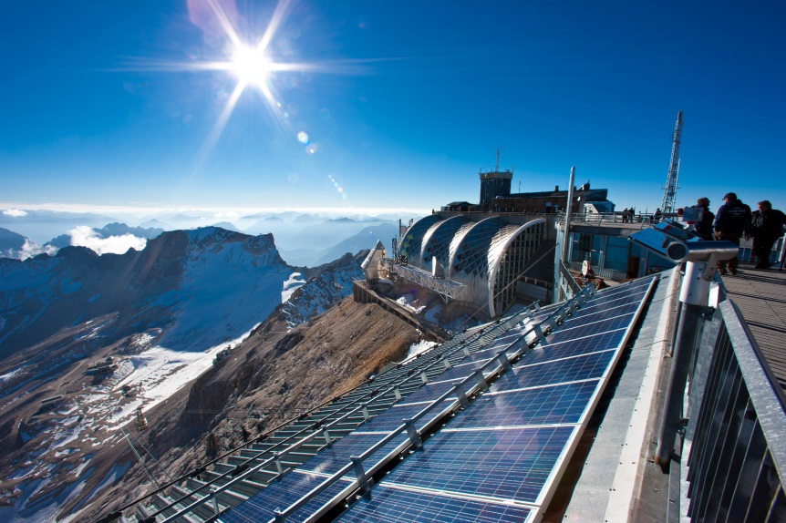
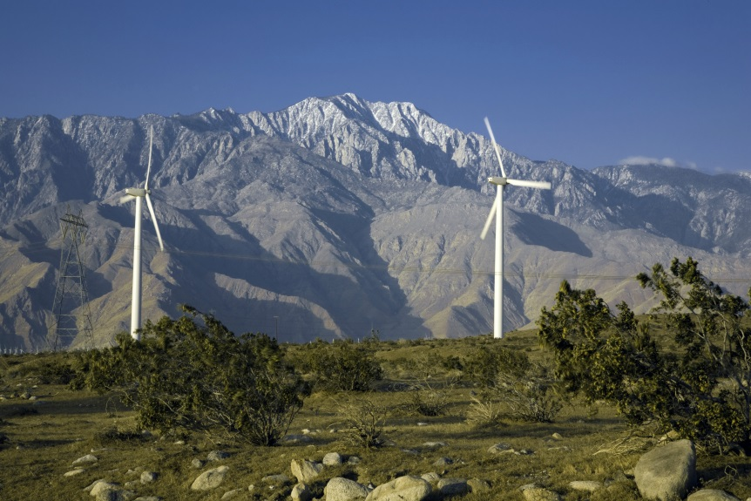
Low-Carbon, Low-Risk Energy
Building wind and solar power capacity is quicker and more affordable than building nuclear—without the financial, environmental, and health risks associated with atomic power
Photo Credit: Wikimedia Commons/ILIOTEC Solar GmbH; Iberdrola Renewables Inc.

Slide 27
THE SOLAR REVOLUTION
Photo Credit: Dennis Schroeder / NREL

Slide 28
The Solar Revolution
Solar PV converts sun’s energy into electricity
Fastest-growing electricity source worldwide
> 50% annual growth 2008–2013
Can scale up from small rooftop systems to massive utility-scale arrays
World Solar-Generated Electricity, 2000-2013

Slide 29
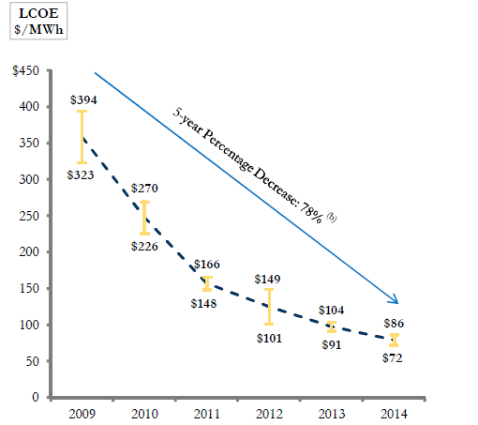
Solar Beating the Grid
Levelized Cost of Energy for Utility-scale Solar PV Systems in the United States, 2009-2014
In growing number of markets, solar-generated electricity now cheaper than grid average
U.S. utility-scale PV system costs down ~80% since 2009
Globally, solar panels cost over $74/watt in 1972
Mid-2014 price: below 70¢/watt
Innovation and policy drove remarkable price decline
Image Credit: Lazard

Slide 30
The Utility Death Spiral
Spread of rooftop PV threatening traditional utility business model
Customers with PV buy less electricity from utility
More PV electricity on grid drives down power prices
Utility forced to raise rates, more people go solar
RWE and E.ON, Germany’s two largest utilities, caught off-guard
Did not anticipate fast rise of solar and wind
Overinvested in fossil fuel and nuclear generation
Now reinventing themselves to survive in new energy landscape

Slide 31
Solar Goals Expanding
Chinese goal for 2020 was 20,000 MW of PV; then 50,000; now it’s 70,000 MW by 2017
India was aiming for 22,000 MW by 2022; government indicates new target will be 100,000 MW
Cumulative Installed Solar Photovoltaics Capacity in Leading Countries, 2000-2014

Slide 32
PV Improving Access to Electricity
For the 1.3 billion people without access to electricity, PV is cheaper than building centralized power systems
India:
Replacing polluting kerosene lamps with PV charging for CFL or LED lamps and a cell phone: 1) lowers monthly outlays, and 2) pays for itself in ~3 years
Bangladesh:
As of 2014, with World Bank help, over 70,000 solar home systems were being installed each month

Slide 33
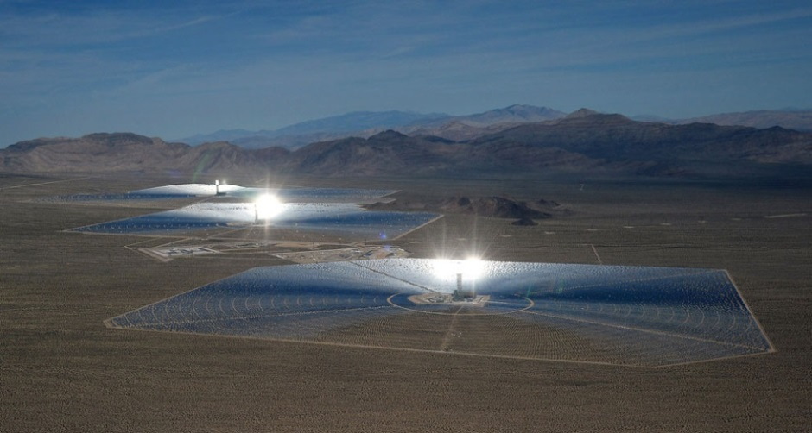
Concentrating Solar Power
In CSP systems, mirrors concentrate sunlight to drive conventional steam turbines or engines
By mid-2014, world had 4,100 MW of CSP, mostly in Spain and the U.S.
Thermal storage in molten salts allows for generation after sundown
Photo Credit: Sandia National Laboratories

Slide 34
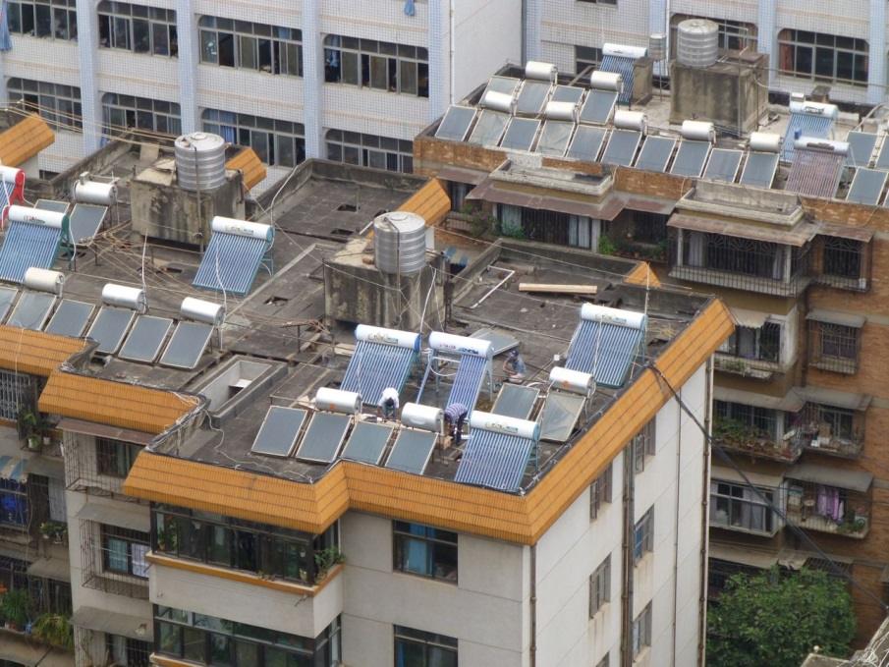
Solar Water Heaters
Rooftop solar thermal collectors heat water directly
China dominates: enough installed rooftop systems to supply 170 million households
Used in some 85% of Israeli homes
Also popular in Europe (e.g. Germany and Austria)
Photo Credit: www.davidlearnschinese.com

Slide 35
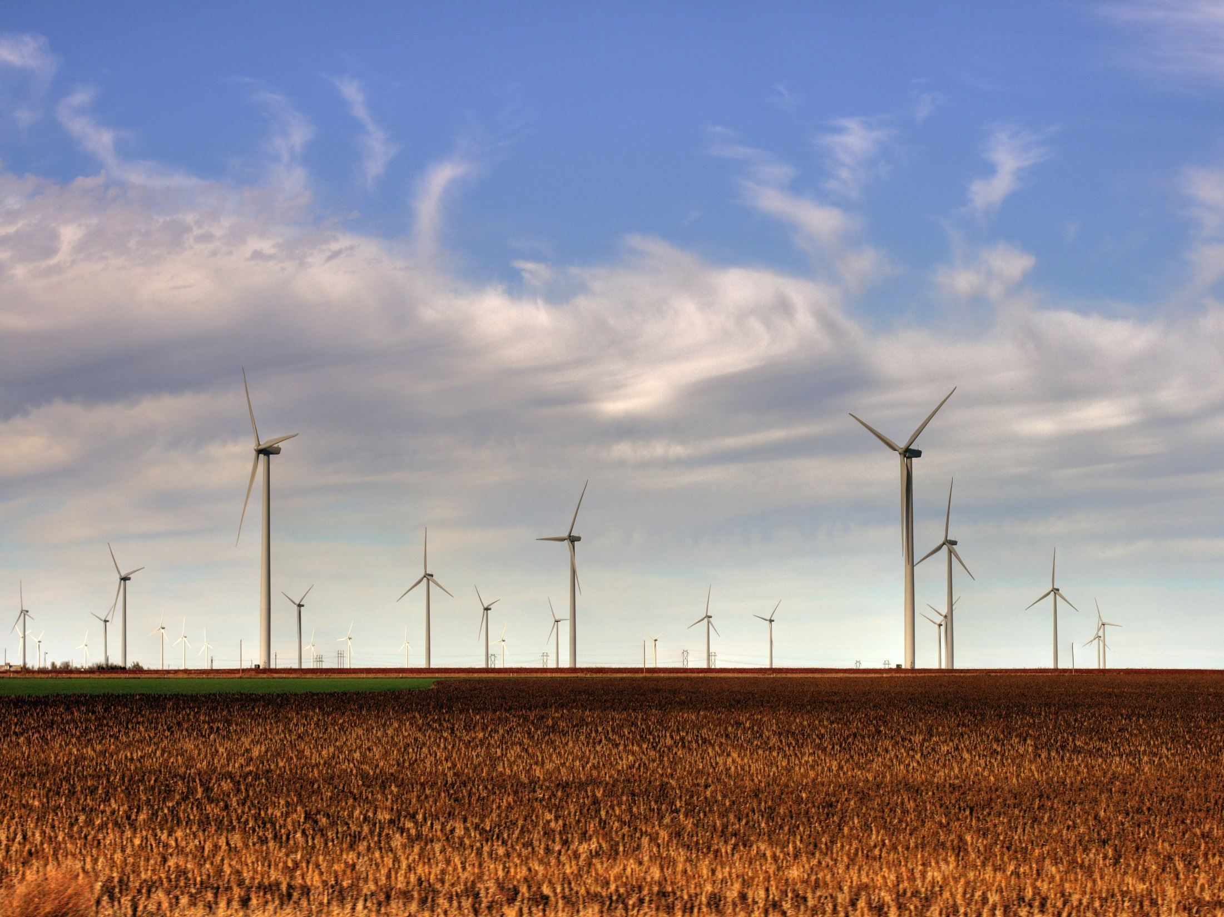
THE AGE OF WIND
Photo Credit: Wikimedia Commons/Drenaline

Slide 36
The Age of Wind
Wind is abundant and widespread
Wind farms are easily scalable, and increasingly cheap
Nearly 370,000 MW installed in some 90 countries produce enough electricity to power 90 million U.S. homes

Slide 37
World Wind Leaderboard
Cumulative Installed Wind Power Capacity in Leading Countries, 1995-2014
In Spain, wind output now exceeds that from coal plants
India targeting at least 60,000 MW by 2022
Offshore installations expanding; half the world’s capacity in the U.K
Development heating up in Latin America

Slide 38
Wind Overtakes Nuclear in China
Wind is now China’s #3 electricity source behind coal and hydro
Wind’s lead over nuclear will grow
Much quicker to build
No water constraints
Wind potential could meet current electricity demand 10 times over
Goal = 200 gigawatts of wind capacity by 2020
Wind- and Nuclear-generated Electricity
in China, 1995-2014

Slide 39
U.S. Wind Power
China has greater installed wind capacity, but U.S. wind farms generate more electricity
Nine states generate >12% of electricity from wind
In Iowa and South Dakota, the share exceeds 25%
If Texas were a country, it would rank sixth in installed wind power capacity

Slide 40
More Wind on the Grid
European countries dominate in the share of electricity generated from wind farms
Four German states get more than 50% of their electricity from wind
On some days wind power exceeds half of Ireland’s electricity generation
Wind Share of Electricity Generation in
Leading Countries, 2014

Slide 41
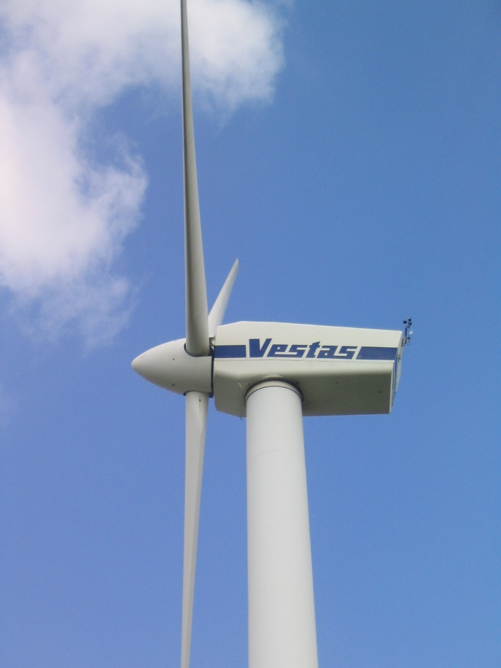
Wind-Powered Denmark
In 1970s, began using electricity taxes to pay for renewable energy R&D
Home to Vestas, world’s #1 wind turbine installer
Got 62% of its electricity from wind in January 2014
For 2014 as a whole: 40%
By 2016, new wind farms will supply electricity at half the cost of new coal or gas plants
Goal is 50% wind by 2020
Photo Credit: Dirk Ingo Franke

Slide 42
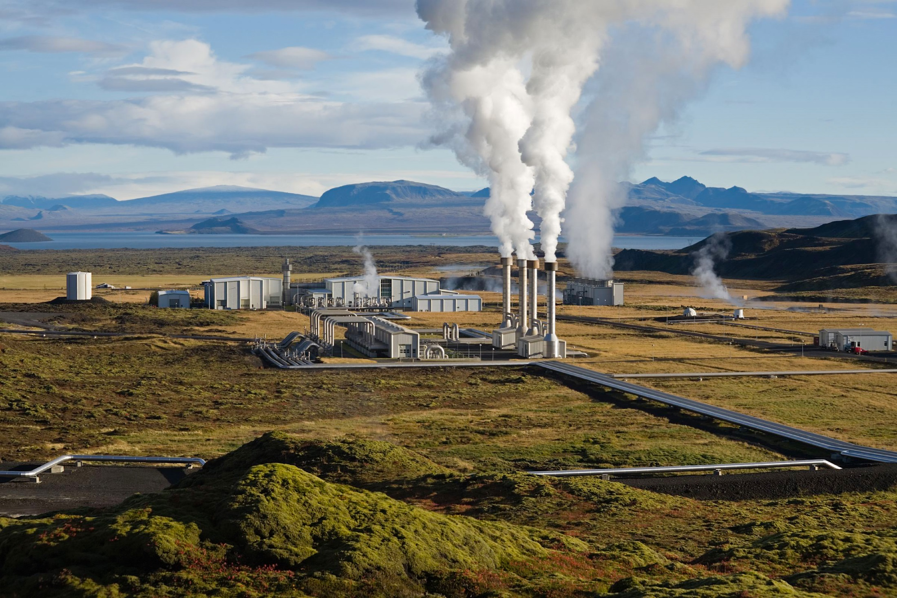
TAPPING THE EARTH’S HEAT
Photo credit: Wikimedia Commons/Gretar Ívarsson

Slide 43
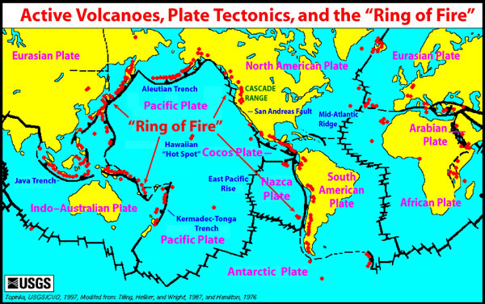
Tapping the Earth’s Heat
Geothermal resources richest in areas with high tectonic activity
Some 40 countries with 860 million people could meet all their electricity needs with geothermal energy
Image Credit: NOAA mod. USGS/Topinka

Slide 44
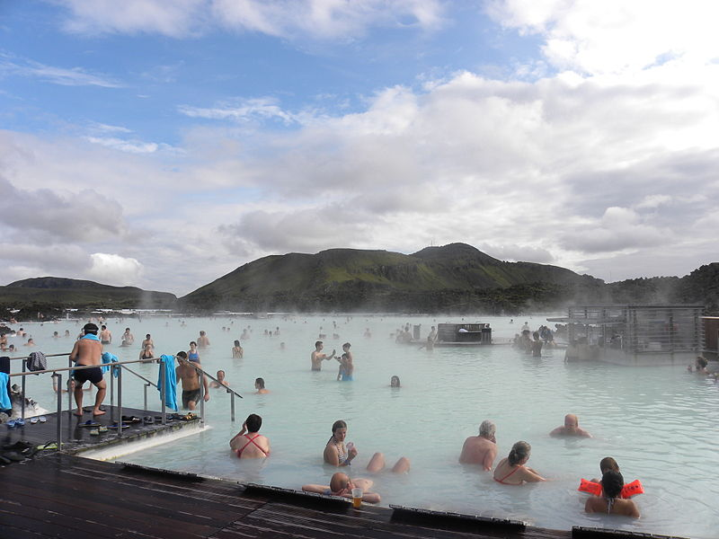
Iceland: Geothermal Powerhouse
Space heating:
In 1970, over 50% came from burning oil, 43% from geothermal
Today geothermal heat covers close to 90%
Other direct uses:
Swimming/bathing, fish farming, greenhouse heating, snow melting
Electricity:
29% of electricity from geothermal, more than any other country
Cheap electricity from geothermal and hydropower allowed Iceland to become a leading aluminum producer
Photo Credit: Wikimedia Commons/Bloody-libu

Slide 45
Geothermal Energy – Direct Use
In China, geothermal district heating rose 5-fold in last decade
Japan has 2,000 spas, 5,000 bathhouses, and 15,000 hotels using nature’s hot water
Ball State University in Indiana expects geothermal heating and cooling to save the school 33,000 tons of coal and $2 million per year

Slide 46
Geothermal Power
Philippines’ goal is 3,300 MW by 2030
Indonesia’s target is 10,000 MW by 2025
Japan has enough geothermal power potential to meet over half its electricity needs
Enhanced Geothermal Systems technology could lead to some 500,000 MW of geothermal power in the United States
Geothermal Electricity-Generating Capacity in Leading Countries, 2013

Slide 47
HYDROPOWER:
PAST AND FUTURE
Photo credit: Grand Coulee, Farwestern / Gregg M. Erickson via Wikimedia Commons

Slide 48
Hydropower Worldwide
World Hydroelectric Generation, 1965-2013
Used in 150 countries
Supplies 16% of the world’s electricity
Global capacity of 1 million MW
Of the world’s 45,000 large dams, 8,600 generate electricity
Pumped storage

Slide 49
Hydropower Development
Hydroelectric Generation in Leading Countries, 2013
Industrialized country rivers near dam saturation
Lower-income countries still expanding hydro
Race is on to develop remaining hydropower frontiers, including the powerful Congo River and rivers originating in the Himalayas

Slide 50
Large Hydropower: a Mixed Picture
Pros
Cons
Abundant energy resource
Renewable
Dams can provide flood control
Can provide irrigation water
Can provide continuous baseload power or quickly ramp on or off
Flooding displaces people, plants, and animals
Weakens river resilience
Traps sediment, shrinking downstream lakes and wetlands
Impedes the movement of fish and other creatures
Reservoirs emit climate-disrupting methane gas
Power distribution required
Expensive: typically >2x original cost estimate, per Oxford study
Long build time; opportunity cost

Slide 51
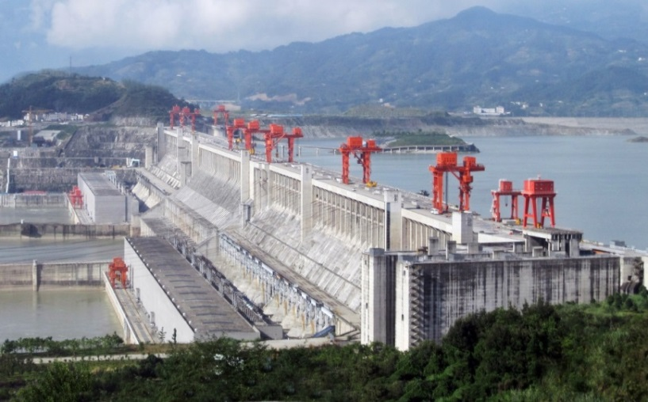
Three Gorges Dam
Location: Yangtze River, China
Online in 2003, complete in 2012
Height: 600 feet
Capacity: 22,500 MW
Annual output: 83 million megawatt-hours
Equivalent to 45 million tons of coal, 12 nuclear reactors
Flooded 244 square miles and displaced 1.4 million people
Total cost could reach $88 billion
Photo Credit: Le Grand Portage
derivative work: Rehman via Wikimedia Commons

Slide 52
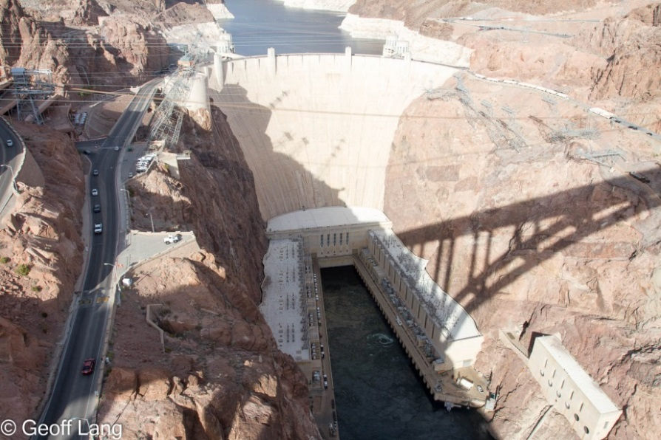
Hydropower in the United States
Supplies 7% of all electricity generation, 51% of renewable generation
Most in Pacific Northwest
Fewer than 3% of the 80,000 U.S. dams generate electricity
Over the last quarter century, nearly 900 U.S. dams have been removed
Powering unequipped dams could ramp up generation
Photo credit: Clubber Lang via Flickr

Slide 53
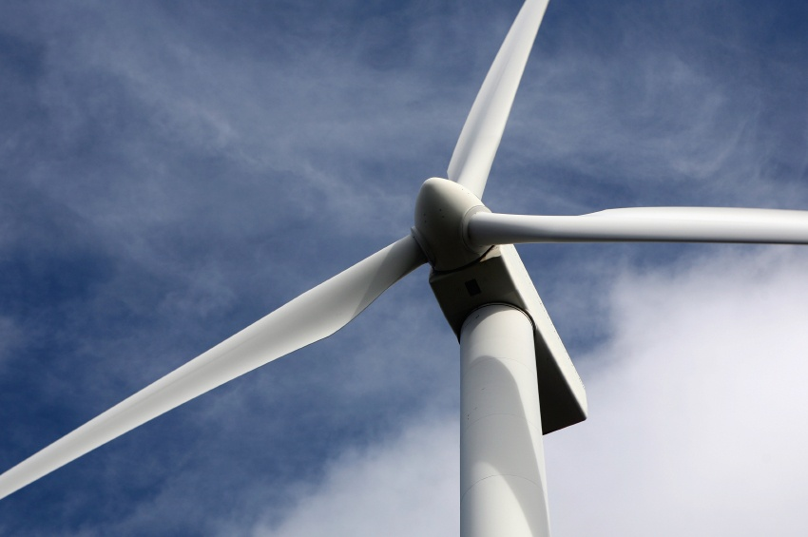
ACCELERATING THE TRANSITION
Photo Credit: iStockPhoto / Joe Gough

Slide 54
Saving Energy Saves Money
Investing in efficiency is less costly than building new generating capacity
Efficiency measures by 11 industrial countries since the 1970s saved $740 billion in avoided energy costs in 2011 alone
A systemic switch from incandescent bulbs to efficient lighting solutions worldwide could allow closure of some 270 coal-fired power plants
Japan’s Top Runner Program is a model for ratcheting up efficiency standards on lighting, electronics, vehicles, and more

Slide 55
Policy Matters
Artificially cheap fossil fuels still heavily subsidized
Renewable feed-in tariffs, tax credits, and energy mandates help level playing field
Unpredictable policy environment has led to boom-bust cycle in U.S. wind industry
Net Annual Installed Wind Power Capacity Additions in the United States, 1998-2014

Slide 56
Putting a Price on Carbon
Can supercharge the transition by systematically pricing carbon to better reflect fossil fuels’ true social and environmental costs
Cap-and-Trade
Regulators set a limit on emissions and polluters can either reduce their emissions or buy permits on the carbon market
EU had first international Emissions Trading System (ETS)
Carbon Tax
Tax levied on each ton of carbon dioxide emitted
Far simpler than cap-and-trade
Potentially revenue-neutral – can be offset by reductions in income taxes

Slide 57
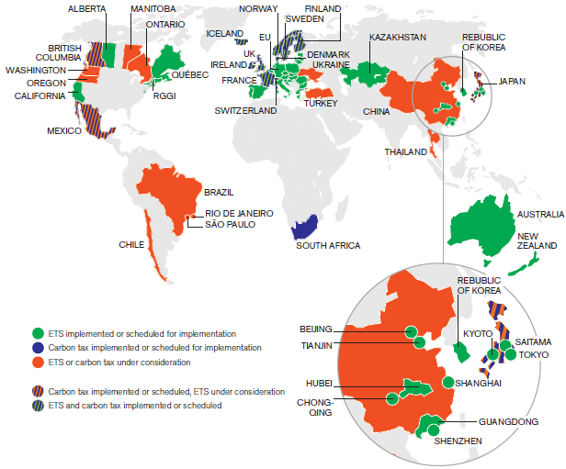
Carbon Pricing in Action
Image Credit: World Bank

Slide 58
Carbon Tax Successes
Ireland: set carbon tax on natural gas and oil consumption in 2010; by 2013, emissions had fallen some 6% while economy grew
British Columbia: set economy-wide carbon tax in 2008; per person consumption of gasoline and other petroleum products fell 15%, three times the national average, while economic growth has kept pace

Slide 59
Fossil Fuel Divestment
Campaign is encouraging divestment from coal, oil, and natural gas companies
Rockefeller Brothers Fund’s original resources came from Standard Oil; now ditching all fossil fuel related holdings
Others divesting from all fossils incl.: Guardian Media Group; Syracuse University
Coal focus: World’s largest sovereign wealth fund (Norway); Stanford University
Photo Credit: 350.org

Slide 60
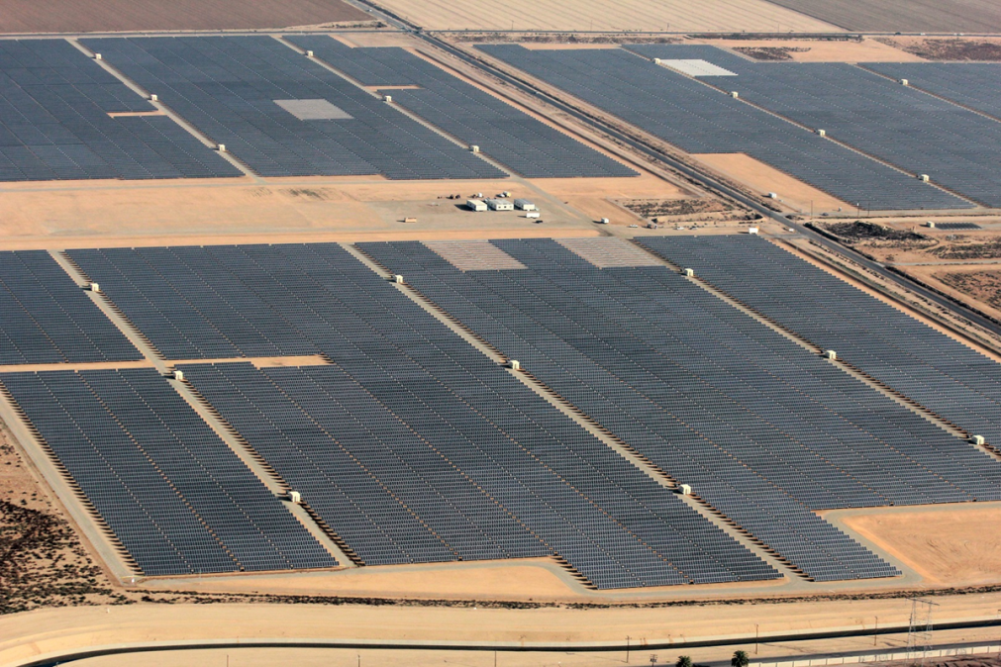
Green Power Purchasing
> 600 entities generate or purchase enough renewable electricity to meet 100% of their needs in U.S.—including Intel, Kohl’s, Staples, Unilever
Google aiming for 100% renewable electricity
Buys staggering amount of wind-generated electricity
Turning abandoned California oil and gas field into an 82-MW solar farm
Image Credit: SunEdison

Slide 61
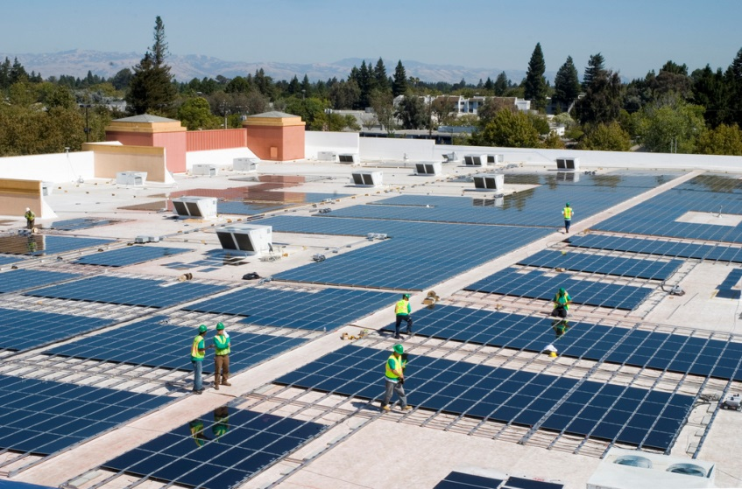
Renewables Make Business Sense
“It’s a business decision. The renewable energy we buy meets or beats prices from the grid.” – Walmart CEO Bill Simon, 2014
Walmart has 260 PV systems on its U.S. buildings, aiming for 400 more by 2018
Apple’s 25-year, $850 million solar power purchase agreement with First Solar to supply CA operations
Large investment institutions like Morgan Stanley and Goldman Sachs channeling tens of billions of dollars into renewable energy
Photo Credit: Walmart/Flickr

Slide 62
Billionaires Betting Big on Renewables
Warren Buffett
$15 billion invested in solar and wind by early 2014
“There’s another $15 billion ready to go.”
Ted Turner
With utility Southern Power, acquired 7 solar PV farms totaling ~300 MW
Philip Anschutz
Will soon have a massive 3,000 MW wind farm under construction in Wyoming to supply CA, NV, AZ
Photo Credit: Todd Spink

Slide 63
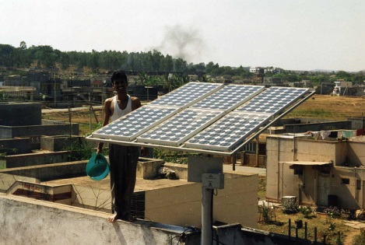
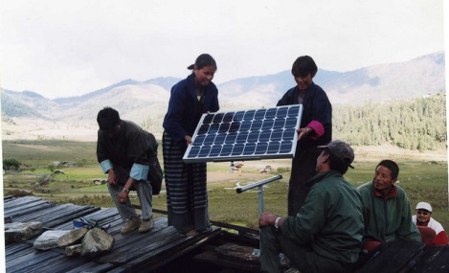
New Energy Economy
Each country can take advantage of its unique mix of renewable resources
Developing countries may bypass the electric grid and jump straight to distributed solar
Photo Credit: Flickr/SELF

Slide 64
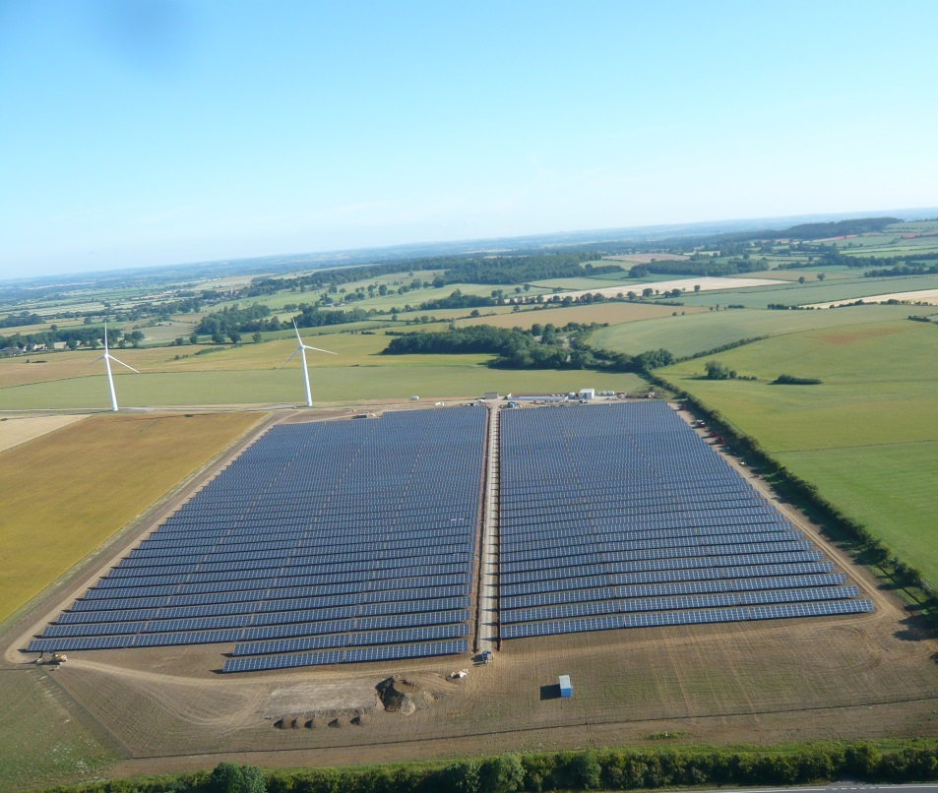
The Future of Energy
Unlike fossil fuels, energy from the wind and the sun
is clean
is inexhaustible
the costs are falling fast
the fuel is free
Photo Credit: MrRenewables via. Wikimedia Commons

Slide 65
Energy Independence
Rooftop solar panels power homes and recharge car batteries, delivering a degree of personal energy independence not known for generations
The old energy economy was tightly controlled by those who held fossil fuel deposits; the new energy economy is much more democratic
Results we can live with: Cleaner air, cleaner water, and a more stable climate

Slide 66
Our Clean Energy Future
The energy transition will change not only how we view the world but also how we view ourselves. Coal plant smokestacks that dirty the air and alter the climate will be replaced by solar panels on our rooftops and wind turbines turning gracefully in the distance.
Welcome to the clean energy era.
– Chapter 9, The Great Transition

Slide 67
To learn more about the energy transition…
read The Great Transition: Shifting from Fossil Fuels to Solar and Wind Energy
by Lester R. Brown
with Janet Larsen, J. Matthew Roney, and Emily E. Adams.
The book and supporting
data are available at www.earth-policy.org

